Slide 1
AI and Social Web
Dr John Gilligan
School of Computer Science
TU Dublin

Slide 2
Social Media and Disability
Communication
Society
Social
Online chats
Shared Interests
Friends and family
Group activities Quiz Night, Book club, Film night
Groups – shared experiences re disability
Shared AT knowledge
People who have difficulty leaving the house
Music Sharing
Videos
Communication
Deaf and non-Deaf
Hearing impaired
People who have difficulty speaking
Verbalisation
Videos and images as an alternative to text
Business
Self employment
Marketing and promotion
Influencers
Recommenders
Advocacy
Building capacity
Evidence gathering
Challenging stereotypes
Highlighting barriers
Examples of Best practice

Slide 3
General Accessibility Issues Social Web
Online Accessibility
Governance
Security and Privacy versus Accessibility
Personal Data Management
Lack of Universal Design Knowledge
Lack of WCAG knowledge
Lack of frameworks around Accessibility
Ineffective Mandates
Lack of Legislation
Inaccessible Products and Services
Inaccessible Overlays
Inaccessible Platforms
Inaccessible Authoring practices
Bad Habits
Ignorance

Slide 4
How AI can help?
Accessibility
Social Media
Speech Technology
Text to Speech
Speech input
Speech Search
Alternative Text
Automatic Alternative Text
Automatic Captioning
Automatic Lipreading
Image Recognition
OCR
Scene Recognition
Accessibility Conformance
Auditing
Overlays
Recommenders
Adaptive Technologies
Learning Styles and Preferences
Adjusting Pace
Automatic configuration e.g. of resolution
User Classification
Engagement
Natural Language Processing/ Authoring
Diversity and NLP Models
NLP and Disability
Predictive Text
Text Simplification
Spell/Grammar Checking
Recommender Systems
Best Practise
Reviews
Web Analytics
Visitor Behaviour
Patterns
SEO
Segmentation
Opinion Mining/Sentiment Analysis
Monitoring
Filtering
Influencers
Haters
Stance Detection
Topic Analysis

Slide 5
AI Issues
AI Technology
Data Set Issues
Technology half working or not working
Fixing errors
Not working with/for disabilities
Not taking context/ or behaviour into account
Ignoring AT models Human-Activity-AT in some context
No Explanations
No Redress
NLP problems Diversity is not your problem its hers
Building negative profiles of people with disability
Negative associations with disability (Hutchinson)
Discrimination Bias and unfairness
Machine learning classifiers train themselves on historical datasets
PWD Misrepresented, Under-represented or excluded from data sets
Inherent bias in data sets
Overwhelmed by the majority
Probabilistic models lean towards the majority
Any problems with data become problems for the classifiers
These problems lead to exclusion or poor representation or poor performance especially when dealing with minorities

Slide 6
Consequences for people with disability
Consequences
Exclusion from Social Media
Unusable Technology
Lack of Connectedness
Not part of the development
Not being Part of the Conversation
Unintended Bias
Negative Models of Disability
Discrimination and loss of civil rights
Policies made on faulty or suspect conclusions due to AI and bad data
Inaccessible Web-analytics – Tables Graphs- Data Visualisations

Slide 7
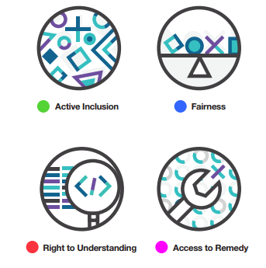
World Economic Forum White paper Report 2018
Recommendations

Slide 8
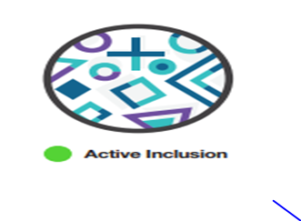
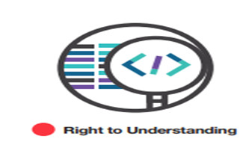
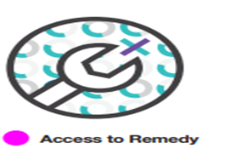
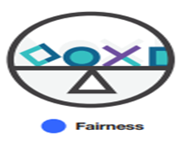
Principles to Eliminate Discrimination
Active Inclusion: The development and design of ML applications must actively seek a diversity of input, especially of the norms and values of specific populations affected by the output of AI systems.
Fairness: People involved in conceptualizing, developing, and implementing machine learning systems should consider which definition of fairness best applies to their context and application, and prioritize it in the architecture of the machine learning system and its evaluation metrics.
Right to Understanding: Involvement of ML systems in decision-making that affects individual rights must be disclosed, and the systems must be able to provide an explanation of their decision-making that is understandable to end users and reviewable by a competent human authority. Where this is impossible and rights are at stake, leaders in the design, deployment and regulation of ML technology must question whether or not it should be used. –
Access to Redress: Leaders, designers and developers of ML systems are responsible for identifying the potential negative human rights impacts of their systems. They must make visible avenues for redress for those affected by disparate impacts, and establish processes for the timely redress of any discriminatory outputs

Slide 9
Active Inclusion
Diversity Expansion
“Diversity expansion can then prevent bias. Only through education can organizations understand the critical need to hire a diverse talent base. It may not be possible to have what some call an “unbiased brain”, but it is possible to bring diverse brains to the table to help prevent it.” —Christian Thilmany, Director, AI Strategy, Microsoft
Building for Diversity
Zhang et al
The role of AI in mitigating bias to enhance diversity and inclusion
Build a diverse organization.
Create an inclusive organizational culture.
Diversity-in-design
Co- Create
Accenture Applied Intelligence
Artificial Intelligence
An AI governance approach to support innovation
Agile development is generally accepted as the best approach to AI initiatives. Collaborative design is central to this, so AI governance should be embedded in the co-creation process.
Deep Learning Indaba
When Deep Learning Indaba was first launched in 2016, it was mostly a collective with a mission to strengthen machine learning and AI in Africa. It was born out of the widespread awareness that African AI specialists were nowhere to be found in international conferences, and evolved alongside similar grassroots organisations – such as Data Science Africa and Black in AI – that choose to focus on research, network-building and training to address the diversity crisis in AI.

Slide 10
Accenture Responsible AI Guiding Principles
Responsible means adopting and scaling AI responsibly and ethically; innovating with purpose; and placing a premium on compliance, accountability, transparency and explainability
Inclusive means taking action for fairness in/with AI: Use inclusive design approaches that incorporate the lived experience of persons with disabilities, and debiasing techniques to create a culture of equality and inclusion.
Accessible indicates that all AI endeavors put a premium on accessibility and that includes features and functionality of the tool itself, the capabilities of vendors involved, the experience of the person with disability surrounding its use
Secure at one level means ensuring that using AI will not put data privacy at risk. However, it also recognizes security in the sense that individuals should not need to ask for help because of their disability (thus potentially depriving them of the autonomy and privacy that would otherwise be protected when using the technology).

Slide 11

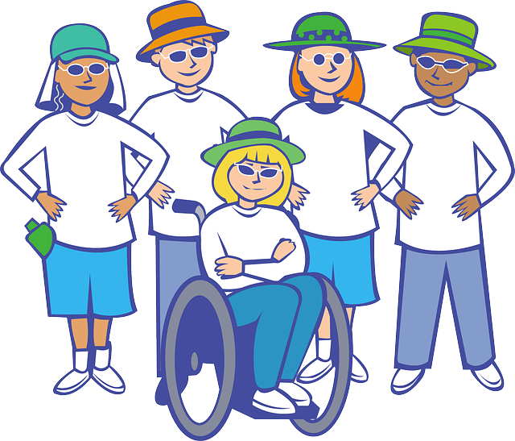
Note
The Principle of Active Inclusion
reflects
The First Principle of Universal Design (Equitable Use)
People Are Not all the Same
Consider a Wide Range of People and their Different Abilities
Principle 1: Equitable Use
The design of a device should be useful and marketable to people with diverse abilities.
Provide the same means of use for all users: identical whenever possible; equivalent when not.
Avoid segregating or stigmatizing any users.
Provisions for privacy, security, and safety should be equally available to all users.
Make the design appealing to all users

Slide 12

A Co-Design Partnership to develop universally designed ICT Applications for people with Intellectual Disability
Co-Design Example
The aim is to work in a co-design partnership on projects to develop ICT applications or products which meet the requirements of the community partners including industrial partners.
Co-designers and students are expected to demonstrate learning in the following areas: Team work ,Project Management, Presentation and Communication skills, Evaluation and Review
The Projects form part of the academic requirements for undergraduate assessment in computing courses.

Slide 13
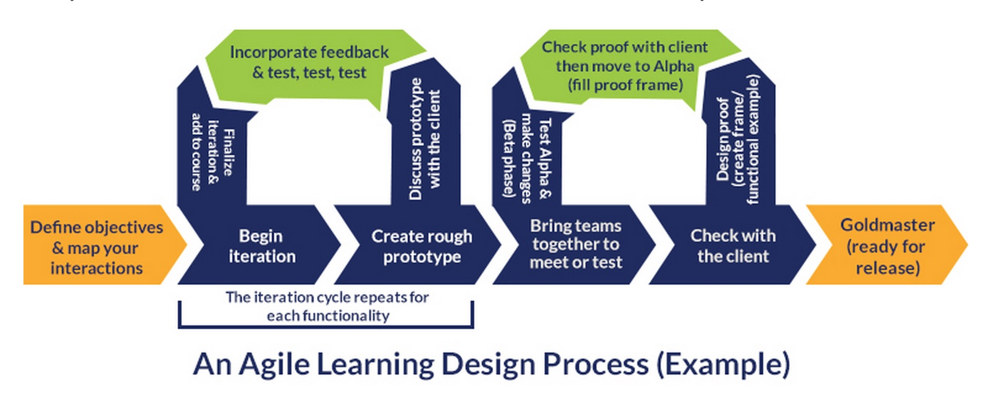
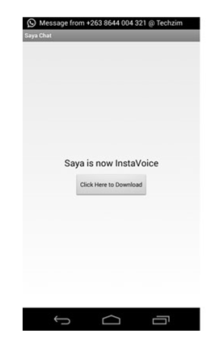
Origin of Partnership
The Partnership emerged from a need of community partner for accessible universally designed apps and a need on the student side to work with real users
Inaccessible Apps
?

Slide 14
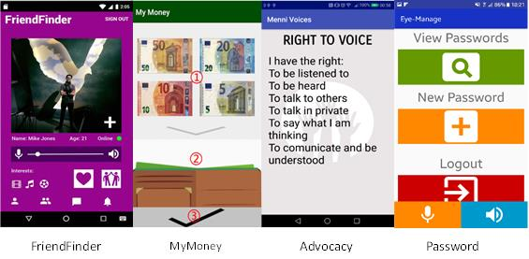
Outcomes
Co-designing
Advocacy & Having a say
The college experience
Teamwork
Developing Apps
Presenting work
User feedback

Slide 15
Pathways
Guo et al Towards Fairness in AI
(1) Identify ways in which inclusion issues for PWD may impact AI systems;
(2) Test inclusion hypotheses to understand failure scenarios and the extent to which existing bias mitigation techniques
(3) Create benchmark datasets to support replication and inclusion (and handle the complex ethical issues that creating such datasets for vulnerable groups might involve); and
(4) Innovate new modeling, bias mitigation,and error measurement techniques in order to address any shortcomings of status quo methods with respect to PWD
Trewin et al
AI systems should be reviewed for potential impact on the user in their broader context of use.
They should offer opportunities to redress errors, and for users and those impacted to raise fairness concerns.
People with disabilities should be included when sourcing data to build models, and in testing, to create a more inclusive and robust system

Slide 16
References
World Economic Forum White paper Report 2018- How to Prevent Discriminatory Outcomes in Machine Learning Global Future Council on Human Rights 2016-2018
http://www3.weforum.org/docs/WEF_40065_White_Paper_How_to_Prevent_Discriminatory_Outcomes_in_Machine_Learning.pdf
https://cloudblogs.microsoft.com/industry-blog/microsoft-in-business/ai/2020/09/10/diversity-inclusion-and-responsible-ai-are-now-the-bedrock-of-bias-prevention/
Zhang H., Feinzig S., Raisbeck L., 2021 The role of AI in mitigating bias to enhance diversity and inclusion IBM Talent Management Solutions Report Contributors: Nigel Guenole, Ph.D., Jenny Montalto, Kimberley Messer
Accenture Applied Intelligence, Artificial Intelligence May 2021 AI for disability inclusion | Enabling change with advanced technology
Accenture Applied Intelligence, Artificial Intelligence, 2019 An AI governance approach to support innovation
https://www.accenture.com/ie-en/insights/artificial-intelligence/ai-governance-support-innovation
https://www.itcilo.org/stories/power-inclusive-artificial-intelligence-training#toc-grassroots-level-support-for-inclusive-ai
Bourke, D. et al. (2018) A Co-Design Partnership to Develop Universally Designed ICT Applications for People with Intellectual Disability, Universal Design & Higher Education in Transformation Congress,30th October -2nd November 2018, Dublin Castle.
Guo, A., Kamar, E., Vaughan, J.W., Wallach, H. and Morris, M.R., 2019. Toward Fairness in AI for People with Disabilities: A Research Roadmap. arXiv preprint arXiv:1907.02227
Trewin, S., Basson, S., Muller, M., Branham, S., Treviranus, J., Gruen, D., Hebert, D., Lyckowski, N. and Manser, E., 2019. Considerations for AI fairness for people with disabilities. AI Matters, 5(3), pp.40-63.

Slide 17
More References
Smith, P., Smith, L. (2020). 'Artificial intelligence and disability: too much promise, yet too little substance?' AI and Ethics, 1, pp. 81–86.
Munro R 2019 Diversity in AI is not your problem, it’s hers Retrieved from https://medium.com/@robert.munro/bias-in-ai-3ea569f79d6a
Hutchinson, Ben & Prabhakaran, Vinodkumar & Denton, Emily & Webster, Kellie & Zhong, Yu & Denuyl, Stephen. (2020). Social Biases in NLP Models as Barriers for Persons with Disabilities. 5491-5501. 10.18653/v1/2020.acl-main.487.
Chung, Joon Son & Senior, Andrew & Vinyals, Oriol & Zisserman, Andrew. (2017). Lip Reading Sentences in the Wild. 3444-3453. 10.1109/CVPR.2017.367.
Youtube automatic Captioning https://support.google.com/youtube/answer/6373554?hl=en
Facebook automatic alt-text https://www.facebook.com/help/216219865403298
Punardeep Sikka and Vijay Mago. 2020. A Survey on Text Simplification . J. ACM 37, 4, Article 111 (June 2020),26 pages. https://doi.org/10.1145/1122445.1122456
Haben Girma https://habengirma.com/
Overlay Fact Sheet https://overlayfactsheet.com/

